Slide 1
MIDTRANS PILLOW FUNCTIONAL TESTING
Yulia Handayani

Slide 2
What to Test?
An e-Commerce Web Application of Midtrans Pillow.
What Feature to Test?
Test Homepage Feature
Test Register Feature
Test Payment Feature:
‘Checkout’ form, ‘Order Summary’ Detail, ‘Select Payment’ Detail, Payment detail

Slide 3
Functional Requirement
User can access https://demo.midtrans.com/ properly
User can successfully register
User can successfully checkout product
User can successfully make a payment

Slide 4
Tools
TOOLS NAME | SPECIFICATION | DESCRIPTION
Google Chrome | Version 100.0.4896.127 (Official Build) (64-bit) | To run automation script
Katalon | Version 8.2.5 | To make automation test case
Trello | Version web app | To report defect

Slide 5
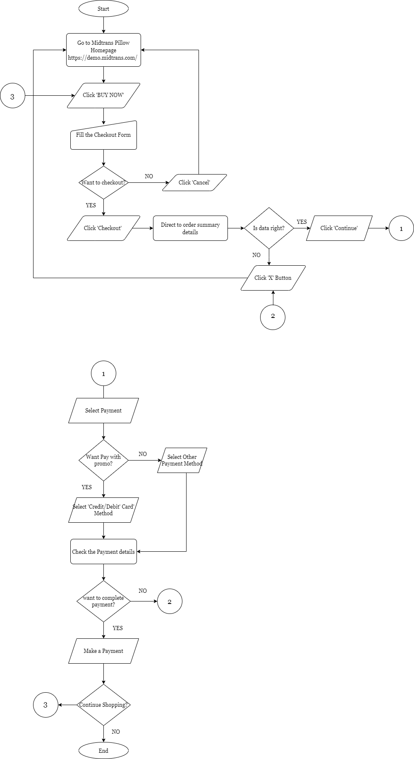

Payment FlowChart

Slide 6
Positive Test Case Summary
NO Test Case | Test Case | Steps | Expected Result
TC01 - TC | User Open Midtrans Pillow Web | Navigate to URL https://demo.midtrans.com/ | Homepage shown properly
TC | User input data on checkout form | Click Buy Now Input valid data on customer details fields | User can see shopping cart and customer detail on checkout form User successfully input data
TC | User successfully directed to order summary detail | Click ‘checkout’ button | User can see order detail and shipping detail with data same as checkout input
TC | User successfully directed to ‘select payment’ detail | Click ‘Continue’ button on ‘order summary’ detail | User can see payment methods with promo and without promo
 | User select payment method with promo | Select credit/debit card payment method | User can amount reduced, order ID and 5 promos on ‘credit/debit card’ detail
 | User select payment method without promo | Select other payment method except credit/debit card | User can see normal amount and order ID on ‘payment method’ detail
 | User successfully paid a payment | Click ‘Pay Now’ and Complete payment | Transaction is successful

Slide 7
Negative Test Case Summary
NO Test Case | Test Case | Steps | Expected Result
TC01 - TC | User input invalid data on checkout form | On customer details, Input invalid : Email Format Phone No Format Postal Code | User failed to checkout
TC | User cancel checkout | Click ‘cancel’ button on checkout form | User directed to landing page
TC | User select payment with 'credit/debit card' without input credential credit card data | User not input card number, expiry date and CVV field on ‘credit/debit card’ detail Click ‘Pay Now’ button | Shown Red Text on Card Number, Expiry Date and CVV Field
TC | User failed paid using denied credit/debit card | Input invalid credential credit card data Click ‘pay now’ Input password on issuing bank Click ‘ok’ button | Transaction Failed Error message "Your card got declined by the bank"
 | User cancel payment on issuing bank | User already directed to Issuing Bank Input password on issuing bank Click ‘cancel’ button | Transaction Failed
 | User select 'klikbca' payment method without input klikbca user iID | Don't Input 'KlikBCA User ID’ field | Shown Red Text on KlikBCA User ID Field
 | User select 'klikbca' payment method with input klikbca user id >10 characters | Input 12345678900000000000000000000 on 'KlikBCA User ID’ field | Shown error message 'Error! Payment data is invalid'

Slide 8
Automation Test Case Summary
NO Test Case | Test Case | Steps | Status
TC01 - TC | User directed to order summary from checkout | Click ‘buy now’ button Input data on checkout form: - Verify shopping cart & customer detail Click ‘checkout’ button Direct to ‘Order summary’ detail: - Verify amount & order ID - Verify tab order detail & tab shipping detail | Success running script
TC | User pay with Credit/Debit card payment method with promo | Click ‘Continue’ Button on Order Summary Select ‘credit/debit card’ Payment Direct to credit/debit card detail: - verify amount & order ID - Input Credit card credential data - verify 5 promos is checkedable - verify email & phone number Click ‘Pay Now’ Directed to Issuing Bank: - verify amount - input password 5. Click ‘OK’ Button 6. Transaction is successful | Success running script

Slide 9
Failed Test Case Report
Click here, go to Trello

Slide 10
Total Test Case
Test Case | Test Case Number | Failed Total | Passed Total
Positive | TC
Negative
Automation
Total Test Case

Slide 11
Thank You

